Slide 1


Introduction to Time Series Data
Wake Forest
School of Business
_______

Slide 2
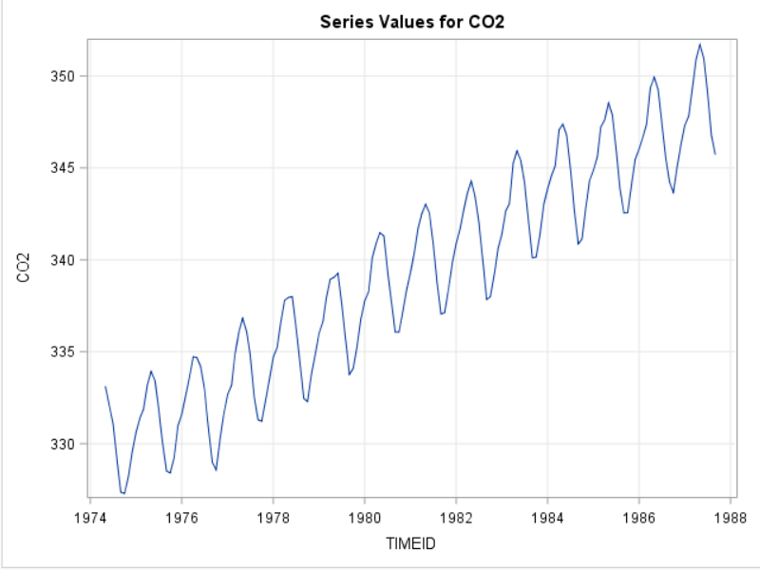
What is a time series?
A time series is a sequence of data points that is evenly spaced over time (hourly, weekly, monthly, yearly, etc).

Slide 3
What is a time series?

Slide 4
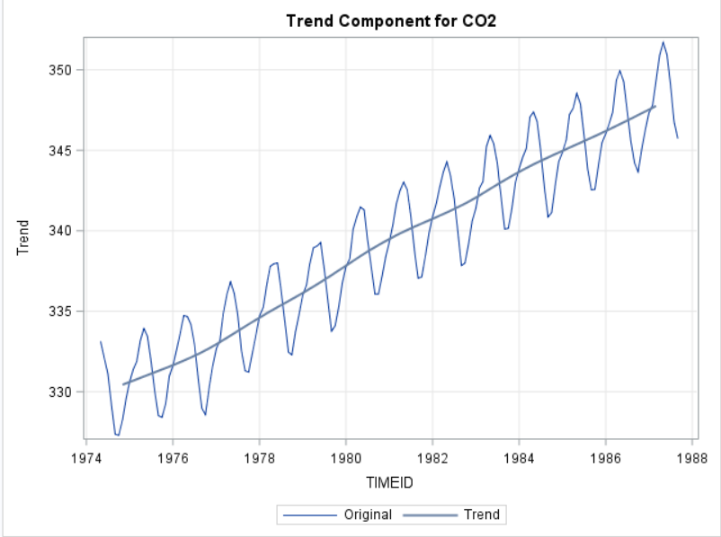
Trend Component
Persistent overall upward or downward pattern
Typically several years in duration
Does not have to be linear
May change direction

Slide 5
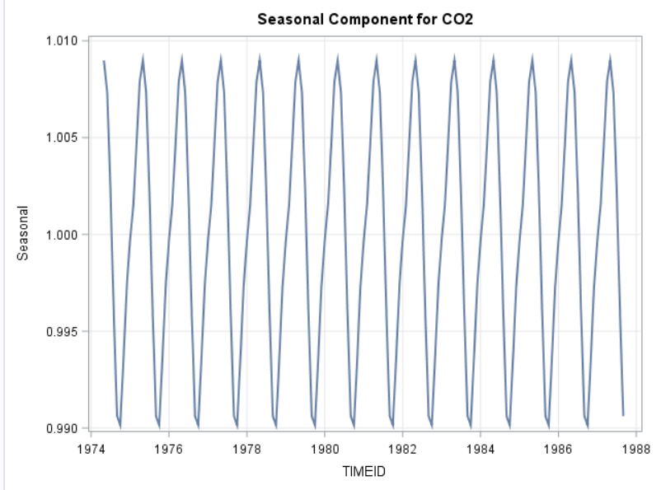
Seasonal Component
Regular pattern of up and down fluctuations
Influenced by seasonal factors (month, quarter, weather, customs, etc)
Of a fixed and known period
Typically occurs within a single year

Slide 6
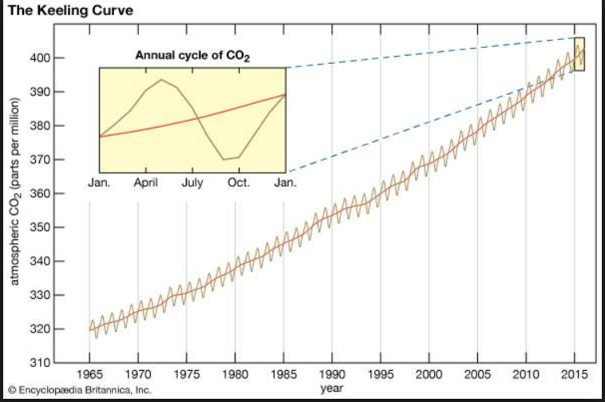
Seasonality in CO2 Emissions

Slide 7
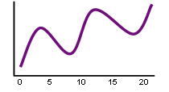
Cyclical Component
Repeating up and down movements that are not of a fixed period
Typically multiple years in duration
May be due to causal or associative relationships
Can be affected by business cycle, political, and economic factors

Slide 8
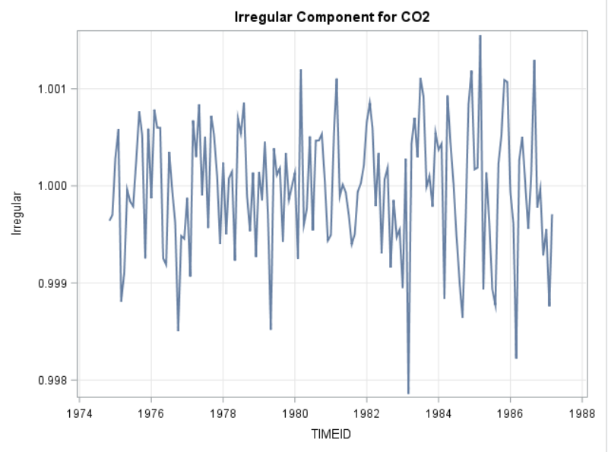
Random Component (Noise)
Erratic, non-systematic, “residual” fluctuations
Due to random variation or unforeseen events
Short duration and nonrepeating

Slide 9
Basic Steps in a Forecasting Task
Problem definition
Gathering data
Preliminary (exploratory) analysis
Choosing and fitting models
Using and evaluating a forecasting model

Slide 10
Forecasting vs Prediction
Prediction: typically uses explanatory variables to characterize expected outcomes or responses
Which customers are likely to purchase an ice cream cone?
What factors are driving the sales of ice cream cones?
Forecasting: primarily uses historical patterns and trends to characterize future performance
How many ice cream cones can I expect to sell next month?
Notes:
In some sense, all forecasts are predictions. However, not all predictions are forecasts.

Slide 11
Forecasting Approaches: Quantitative Methods
Naïve approach
Trend projection
Linear regression
ARIMA models
Exponential Smoothing

